Slide 1

Blockchain Technology
Edited By: Abdullah Abdul Jalil

Slide 2

The history of Bitcoin
2008
Idea was published under the pseudonym Satoshi Nakamoto
2009
Start of the Bitcoin Network
2010
Fist cryptocurrency stock exchange is launched
2011
One Bitcoin equals one USD

Slide 3
The history of Bitcoin
2013
1 Bitcoin equals
100 USD
2014
Microsoft accepts Bitcoin
2017
1 Bitcoin equals
10,000 USD

Slide 4
Bitcoin ≠ blockchain
Is an application of blockchain technology
Is the underlying Data Structure, which can be used for many things, including cryptocurrencies

Slide 5
As we said previously,
Satoshi wanted to build a financial system
in which there is no central authority or third party,
And that he relied on building this system on blockchain technology.
But,
Why Blockchain ?
To answer this question, you must first know what blockchain is, and what is the basic technologies on which Blockchain depends

Slide 6
What is A Blockchain?
In general, a blockchain is a growing list of data blocks that are linked together.
Do you know linked list ?
Data
Data
Data
Reference
Reference
Reference

Slide 7
Key Features of a Blockchain Network
Distributed Ledger Technology:
Instead of hosting its information on a single centralized server, a blockchain distributes its ledger to each computer in the system. These computers are called nodes, and they are responsible for storing, sharing, and recording information and the transfer of digital assets. This is the basis of “distributed ledger” technology, and it’s the only way in which blockchains can store information securely.
But now, there is a new problem
How can we ensure data security even when it is distributed across multiple devices?

Slide 8
The answer in the second Feature:
Immutable Records Technology:
Next, a blockchain has a unique way of storing that information: within blocks. These blocks of new information are arranged in a chain, which is distributed across the network, hence the name ‘blockchain’.
To clarify, this specific data structure ensures that it is impossible to alter information once included in the blockchain.
These features make blockchains almost impossible to hack.
But now, I don't understand how this structure ensures data security?

Slide 9
Hashing
Hashing is a process of converting input data (or a message) of any size into a fixed-size string of characters, which is typically a sequence of numbers and letters.
Key characteristics of hashing include:
Deterministic: For a given input, a hashing algorithm always produces the same hash code.
Irreversible: Hash functions are one-way functions, meaning that it is computationally infeasible to reverse the process and obtain the original input data from the hash code.
Fixed Output Size: Regardless of the size of the input data, the output hash code is of fixed size.

Slide 10
The hash code doesn’t just include the information of the block it corresponds to, it also includes information on the previous block in the chain.
This means if anyone alters one block, it will also alter its hash and therefore every subsequent block in the chain.
This makes any potential edit very noticeable to the whole network, meaning it is secure.
The earlier the transaction is in a blockchain’s history, the harder it becomes to alter the data.
This capability means blockchains are a unique medium for storing valuable data.

Slide 11
How Does A Blockchain Work?
As mentioned, a blockchain network stores data on all the computers participating in the network, otherwise known as nodes.
Crypto nodes contribute to the security of the network by taking part in the transaction validation process.
Each of these nodes stores information in blocks. Then each of these blocks is arranged in a chain.
Every time the network processes a transaction, the chain grows.

Slide 12
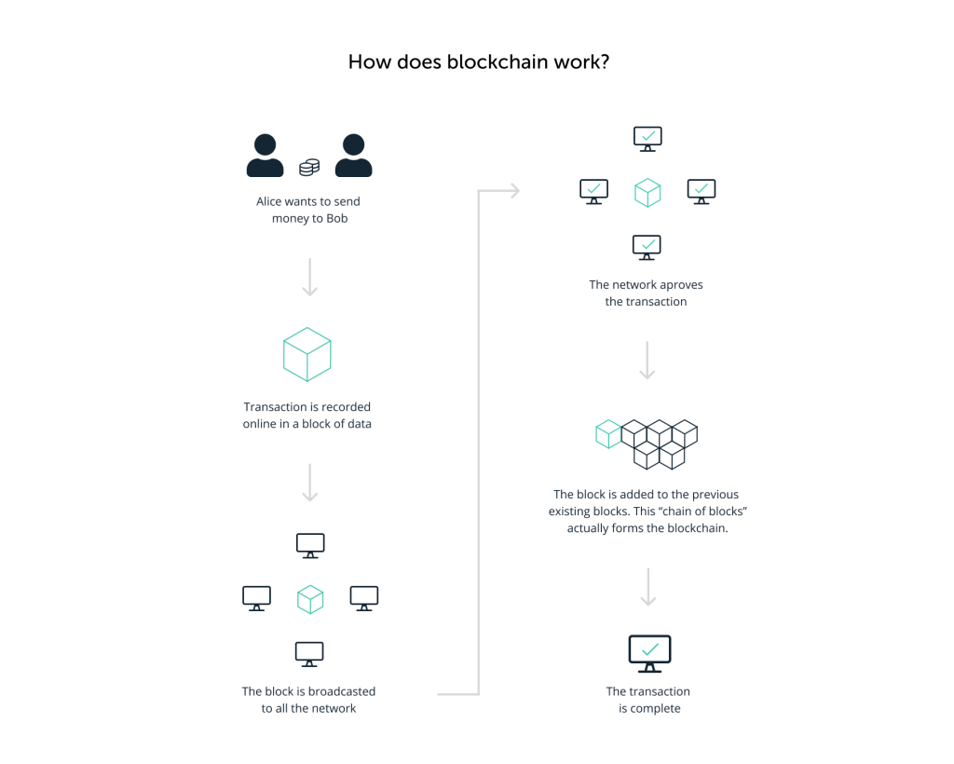

Slide 13
you might wonder who actually adds the transaction to a block and broadcasts it ?

Slide 14
Miners & Validators
most blockchains have a set of special nodes that can add new blocks to the chain.
On proof-of-work blockchain, like Bitcoin, those are miners.
and these participants create new blocks by solving complex mathematical problems, which requires specialized equipment and a lot of energy.
The miner that solves the puzzle first receives both a block reward and the transaction fee. However, this requires specific hardware and a lot of energy.
On a proof-of-stake blockchain these block creators are named validators.
So, each blockchain has a different method of choosing a block creator, and it’s these special nodes which are responsible for creating blocks.

Slide 15
What’s to stop a node from lying about
the state of the network for its own gain?

Slide 16
Consensus
This is the cleverest part of a public blockchain: There are thousands of nodes scattered across the planet, and the majority of them must verify each new transaction before it can join the blockchain.
Once the block is added, every node in a blockchain must arrive at the same state. This is called achieving consensus.
With the management of the blockchain ledger distributed so widely,
no single entity can gain control of the network or validate false information.
This makes the whole network secure.
But the way in which these nodes process transactions differs slightly depending on the consensus mechanism the blockchain uses

Slide 17
Different Consensus Mechanisms
Public blockchains have two main categories of consensus mechanisms;
Proof-of-work and Proof-of-stake.
Proof-of-Work (POW): A slower, secure consensus mechanism, which uses miners to create
new coins and process transactions by solving complex puzzles which take a lot of computational power.
This keeps the network secure as it makes the system pointless for miners to try and cheat.
the cost of using that much energy is simply too expensive to make it worth it.
A good example of a POW blockchain is Bitcoin.
Proof-of-Stake (POS): A faster, energy-efficient consensus mechanism that uses validators to process
transactions. Instead of using computational power to prove their trustworthiness,
validators in a POS blockchain use significant amounts of crypto as collateral.
In short, they receive rewards for acting well and are punished for acting maliciously.
A good example of a blockchain that uses this system is Ethereum.

Slide 18
Bitcoin ecosystem
More Security
More Participants
Increased Bitcoin Value

Slide 19
Blockchain: What’s the Excitement About?
While you may correspond blockchain technology directly to cryptocurrencies,
there’s actually a lot more to it than that. Blockchain isn’t just about crypto and finance,
these networks are also capable of some other novel uses.
For example, decentralized finance apps which allow lending and borrowing are only possible
due to this capability. Plus, blockchain games and blockchain art in the form of
Non-fungible tokens (NFTs) become possible too.
Blockchain technology even has the power to change the way we govern things.
That’s because tokens and coins make it possible to create complex decentralized voting systems
in the form of Decentralized Autonomous Organizations (or DAOs).
As the innovation in the web3 industry grows, the potential for more and more use cases
grows along with it. Put simply,
Blockchain technology is here to stay and who knows what else it could do in the future.

Slide 20
Useful recourses for Blockchain
What is Web 3.0? | Ledger (tutorial)
المخبر الاقتصادي كريبتو - YouTube (playlist)
Blockchain 101 Tutorial: Introduction & Overview - كورس شرح البلوك تشين – YouTube
please skip the intro, it contains music :)
Free Blockchain Course - 101 Blockchains
For visualization demo: Blockchain demo

Slide 21
MongoDB
MongoDB is a popular open-source NoSQL database program.
It uses a document-oriented data model, where data is stored in flexible, JSON-like documents
Here are some key features and concepts associated with MongoDB:
Document-Oriented: MongoDB stores data in flexible, JSON-like documents.
Each document can have a different structure, which means that data doesn't need
to be stored in rigidly defined tables with a fixed schema.
2. NoSQL: MongoDB is a NoSQL database, which means it doesn't rely on the traditional
relational database model with tables and rows. Instead,
it offers greater flexibility and scalability for handling unstructured or semi-structured data.
3. High Performance: MongoDB offers high performance for both read and write operations.

Slide 22
NoSQL VS SQL DBs
Aspect | SQL DB | NoSQL DB
Data Model | Tabular | Document-oriented
Schema | Fixed schema | Flexible, schema-less
Performance | High performance, but may vary based on query complexity and indexing | High performance for read/write operations
Use Case | Transactional systems, ERP systems, complex relationships | Real-time analytics, content management, applications with rapidly evolving schemas

Slide 23
Hazelcast
Hazelcast is an in-memory data grid platform that provides distributed computing capabilities
for Java applications. It is designed to store and process large volumes of data in a distributed
and highly available manner across a cluster of machines.
In-Memory Data Grid (IMDG):
Hazelcast operates as an in-memory data grid, meaning it stores data in the RAM
of multiple machines within a cluster. This allows for extremely fast data access and processing.
Distributed Architecture:
Hazelcast distributes data and processing across multiple nodes in a cluster,
providing scalability and fault tolerance. Data is partitioned and replicated across nodes
to ensure high availability and fault tolerance.
Overall, Hazelcast is a powerful platform for building highly scalable,
distributed applications that require fast data access, low latency, and high availability.

Slide 24
Use Cases:
Caching: Hazelcast can be used as a distributed cache to improve the performance
of applications by caching frequently accessed data in memory.
Data Processing: Hazelcast is suitable for use cases involving real-time data processing,
analytics, and stream processing.
High-Volume Transactions: Applications with high-volume transactional requirements
can benefit from Hazelcast’s ability to handle large volumes of data with low latency.

Slide 25
Thank you

